Slide 1
4th Global Forum on Development of Computer Science
Cultivating Progress: Computer Science Education for Societal Advancement. An European Perspective
Josep Fernandez
Dean. Barcelona School of Informatics, Spain

Slide 2
Agenda
From past to present
ICT impact & employment
Talent shortage
Strategies to address talent shortages
Closing remarks

Slide 3
Once upon a time in the early 80’s

Slide 4
From past to present
Computers were magic
Coding was an adventure
Computers were a tool to learn and create solutions
Fast Technology growing

Slide 5
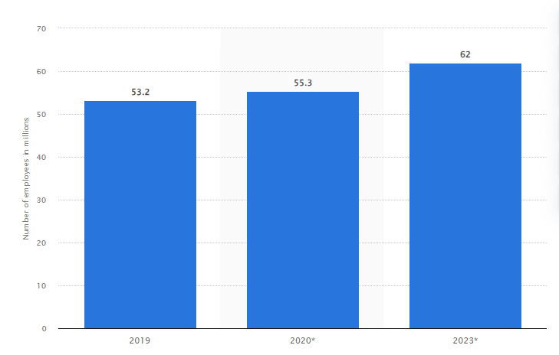
ICT Employment
Full-time employment in the ICT industry worldwide in 2019, 2020 and 2023 (in millions)
Source: https://www.statista.com/statistics/1126677/it-employment-worldwide/ © Statista 2024

Slide 6
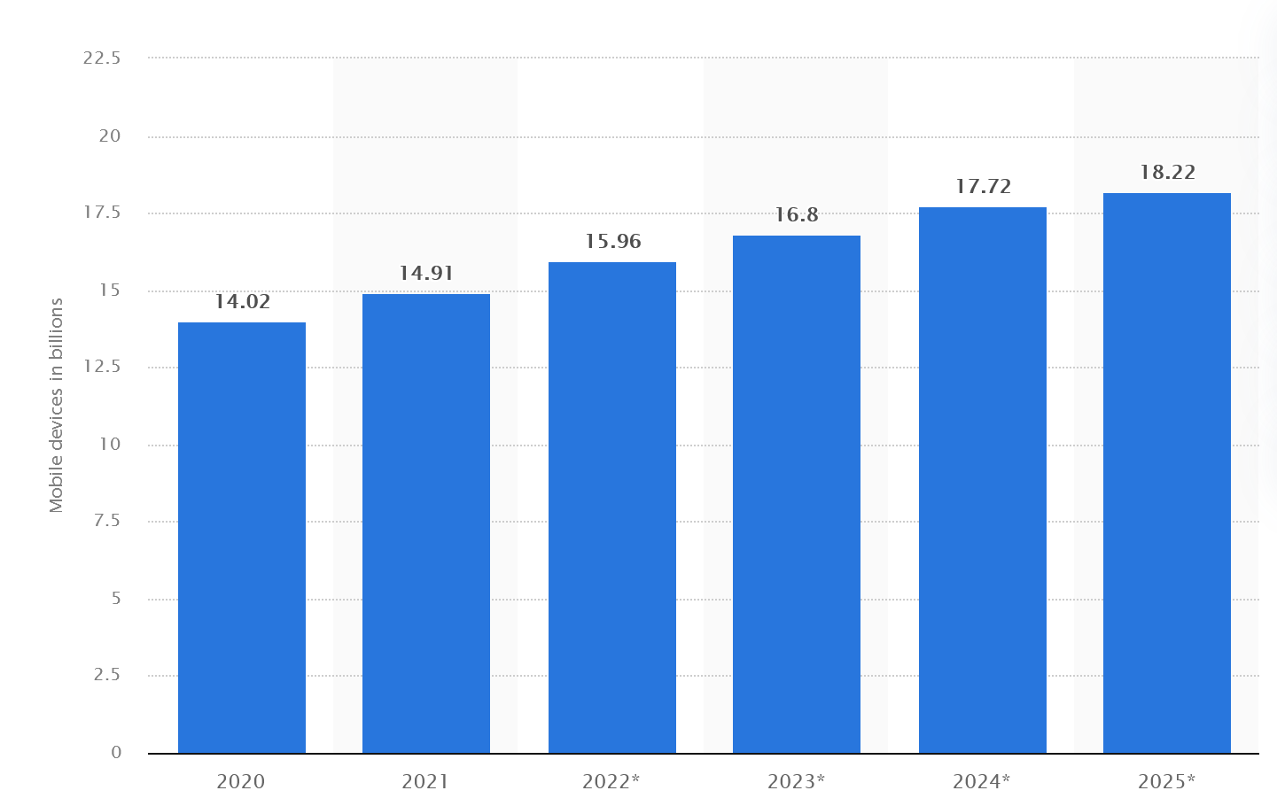
ICT Impact
Forecast number of mobile devices worldwide from 2020 to 2025 (in billions)
https://www.statista.com/statistics/245501/multiple-mobile-device-ownership-worldwide/

Slide 7
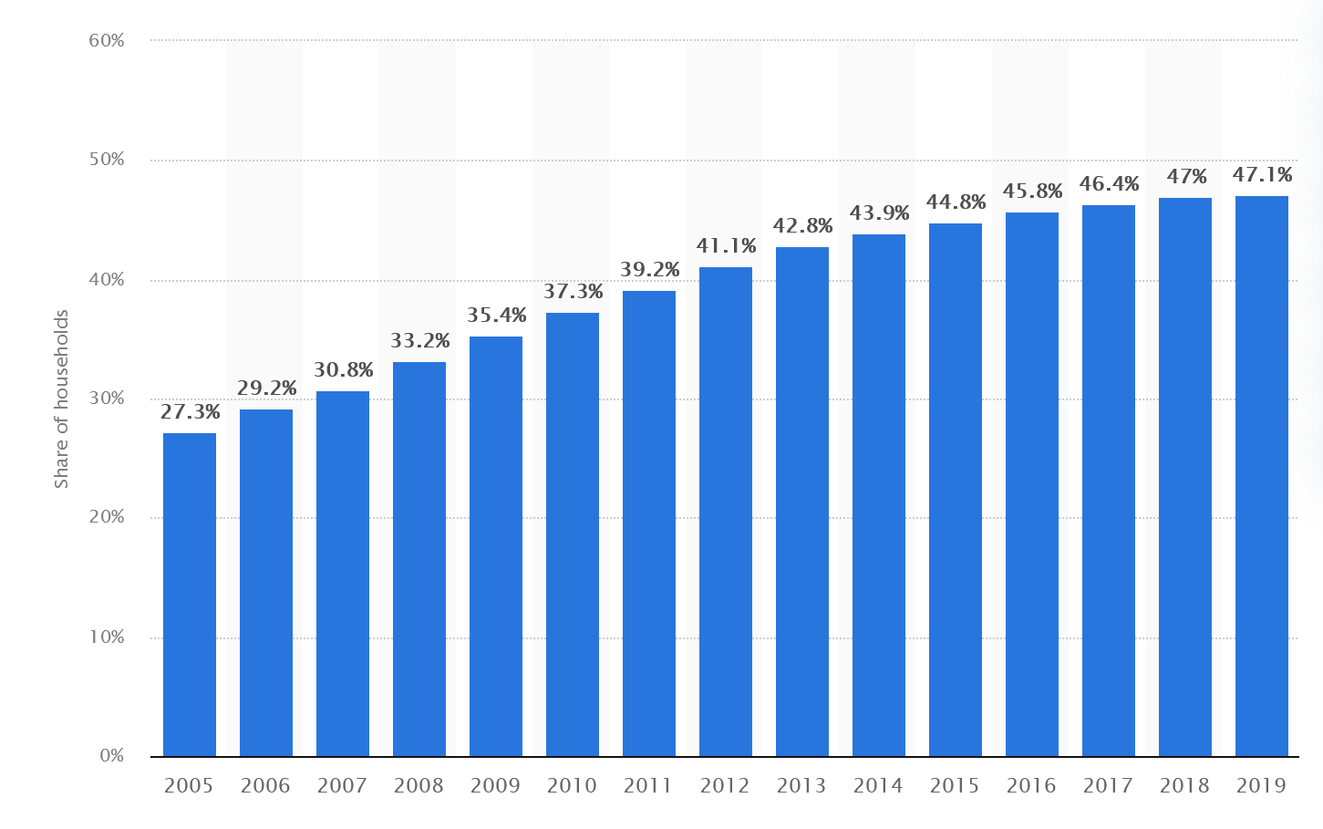
ICT Impact
Share of households with a computer at home worldwide from 2005 to 2019
https://www.statista.com/statistics/748551/worldwide-households-with-computer/ © Statista 2024

Slide 8
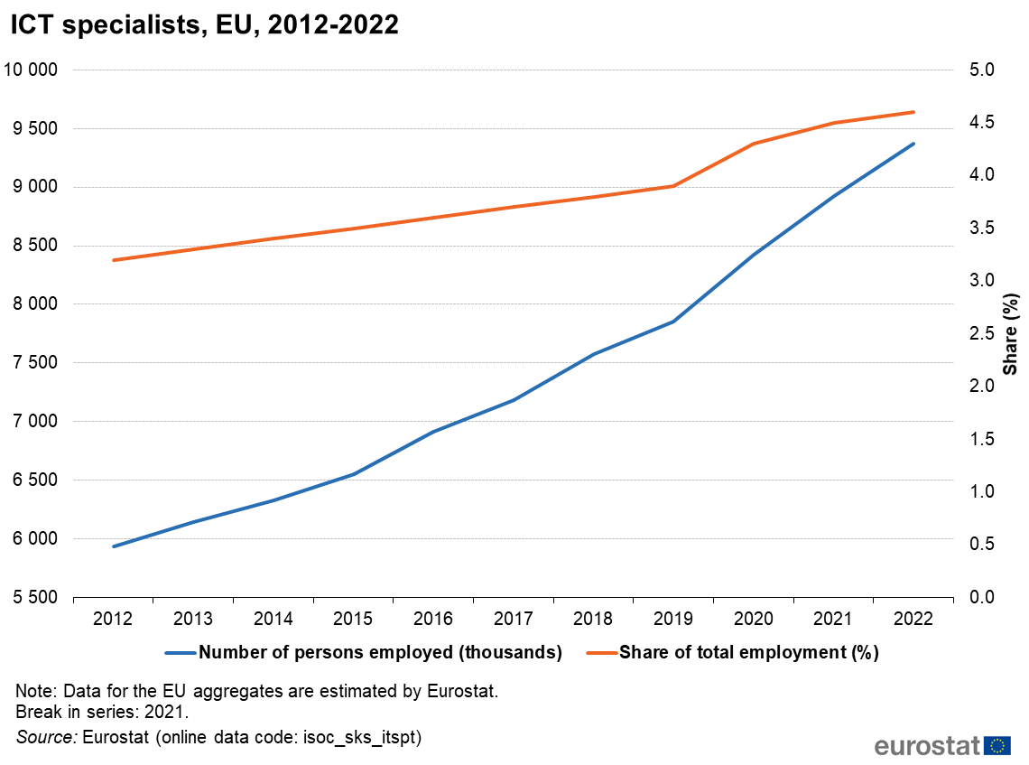
IT Employment in EU

Slide 9
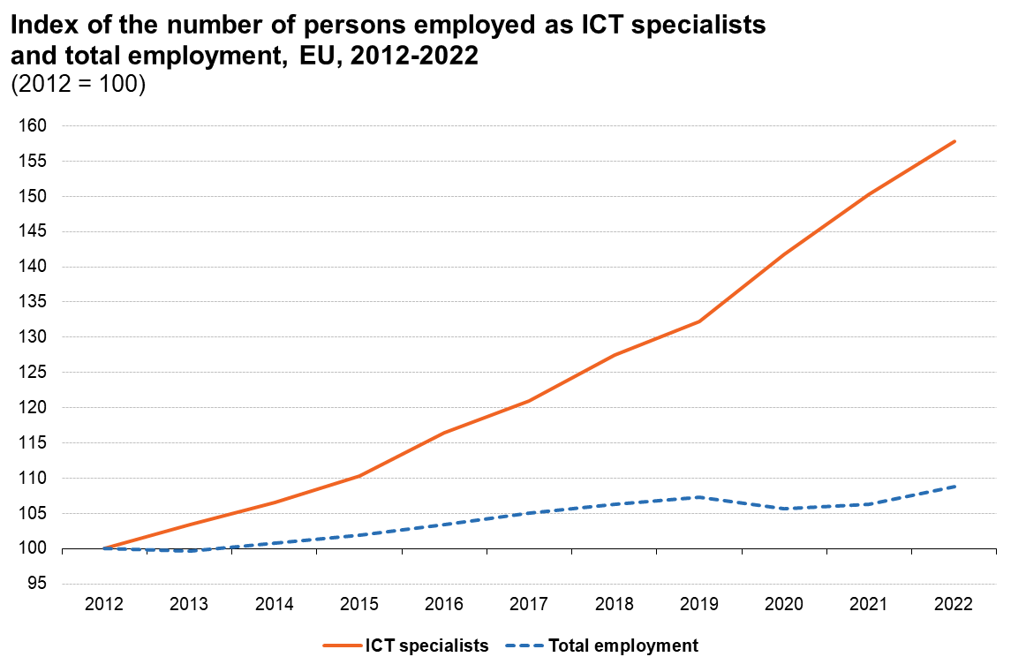
ICT Employment in EU

Slide 10
IT Employment in EU

Slide 11
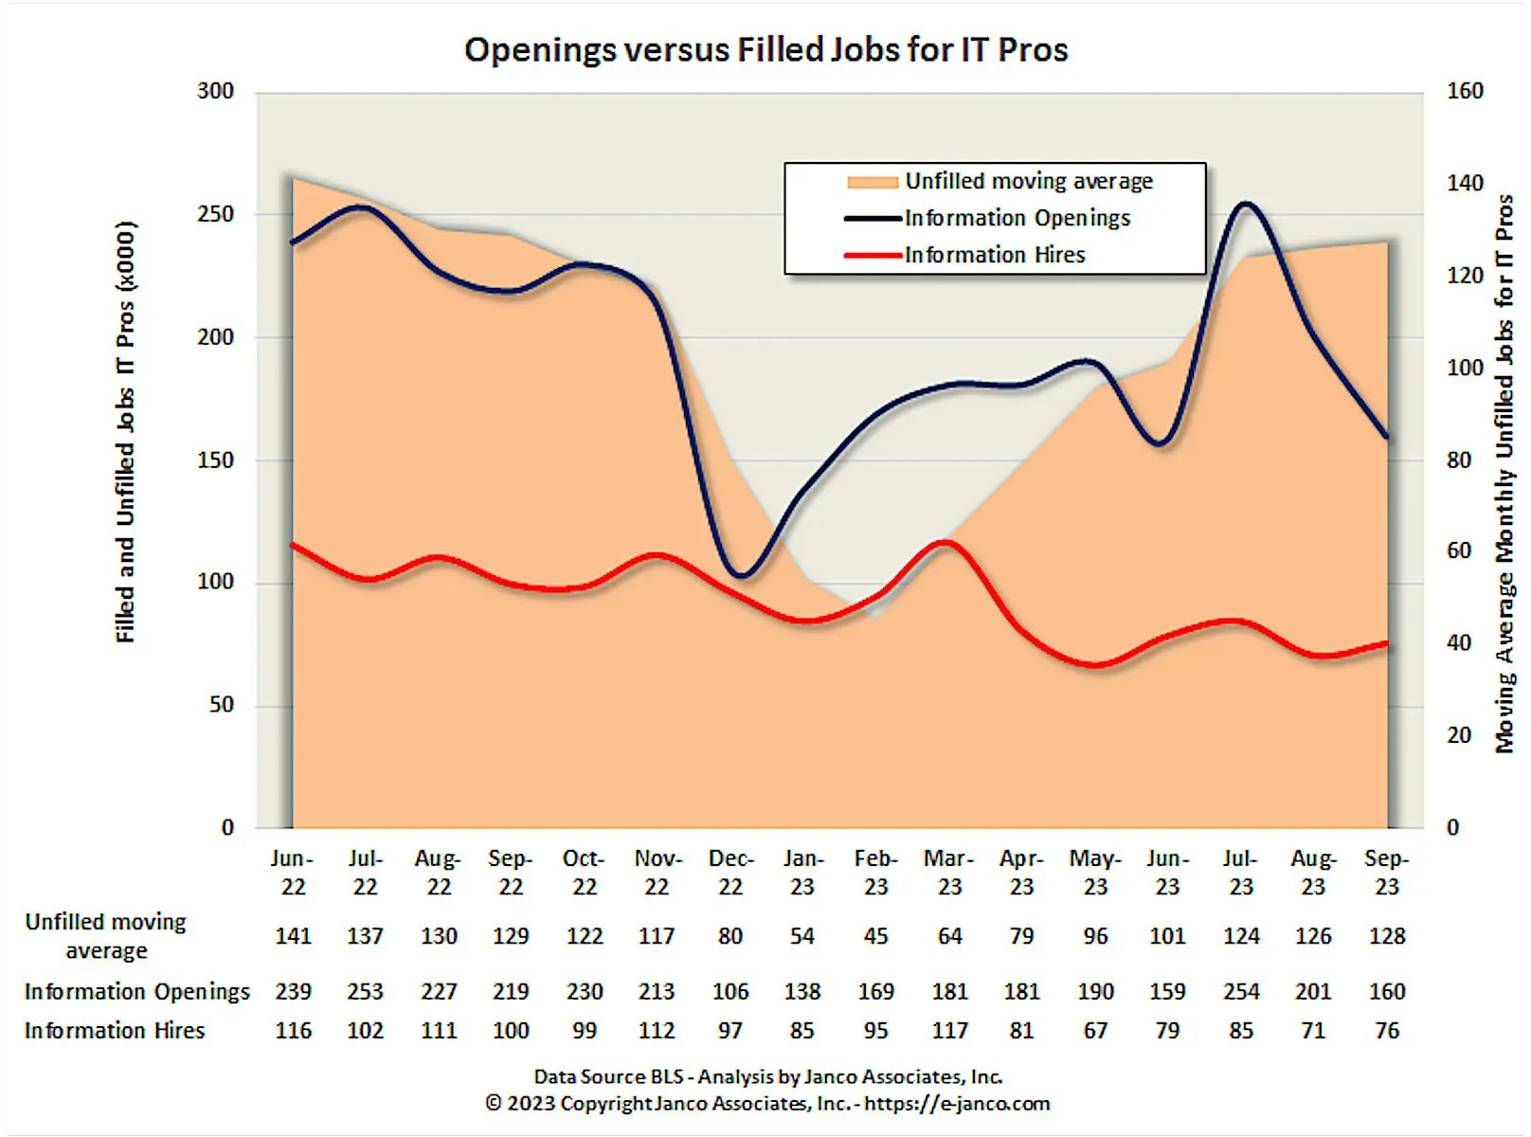
Talent shortage

Slide 12
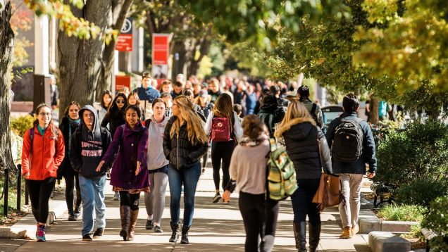
Strategies
Job
Market
Prospective
Students

Slide 13
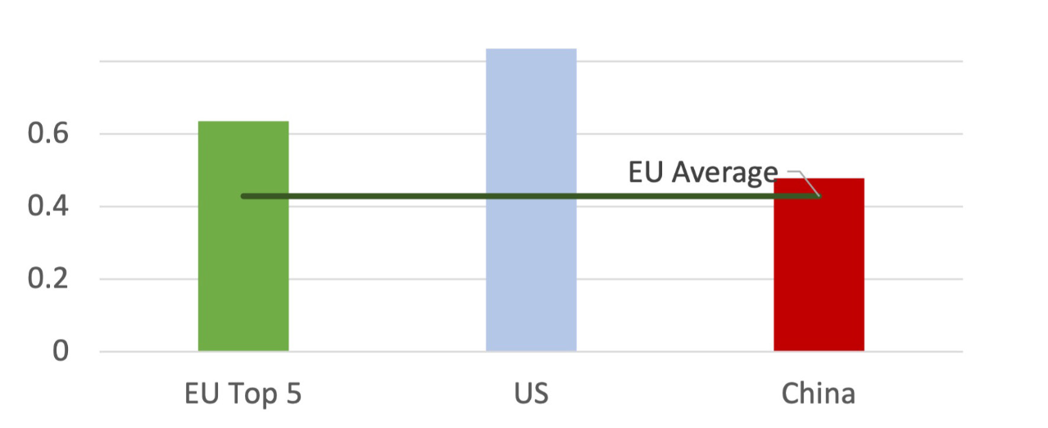
Talent shortage
Universities does not produce enough
talent for job market
Differents reports suggest that it is more an offer problem that a demand problem

Slide 14
Actions at university level
Inspire Attract
Educate Boost

Slide 15
Actions to inspire with tecnology
Bring Students to Campus. Discover digital tecnologies having positive experiences
Interactive workshops
hackathons, coding competitions
Computer history museum
Collaborate with local Schools and IT Companies
Promote Diversity
Teacher and Parental Involvement
Incorporate IT in Curriculum

Slide 16
Actions to attract future students
Career Guidance
Meet Industry Demands
Offer a Relevant Curriculum
Innovation and Entrepreneurship
Internship and International Opportunities
State-of-the-Art Facilities
Marketing and Branding

Slide 17
Actions to educate students
Comprehensive and Engaging Curriculum
Hands-On Real Projects
Soft Skills Development
Flexible Learning Options
Global Opportunities
Community Building
Networking Opportunities
Wellness and Support Services
Continuous Communication

Slide 18
Actions to boost professional growth
Continuous Professional Development
Career Guidance Services
Entrepreneurial Support
Ethical Leadership and Soft Skill Training
Alumni Engagement Programs
Recognition and Awards

Slide 19
Closing Remarks
Talent shortage has been a constant throughout computing history. Now is an serious problem
Cooperation between all stakeholders, such as policymakers, industry, and universities is needed
Universities have to collaborate even in a context of competition for the best students

