Slide 1

Developing AI
Education Programs
at HKUST
Prof. Xiaofang Zhou
Notes:
A young department/university of 32 years
A medium-sized CS department of 50 faculty
We are very proud of what we have achieved

Slide 2

HKUST– Established in 1991
Notes:
10K UG + 7K PG
Sci, Eng, Biz, Social and humanity, AIS, and in the future Medical School

Slide 3




HKUST – CSE rankings
World’s Top 700 Universities in Computer Science
(#1 in Hong Kong for 11 times in 13 years)
QS World University Rankings 2023
No.40
No.31
(retained the No.1 place in Hong Kong for 8 years in a row)
Times Higher Education World University Rankings (2024)
No.18
CS Rankings (2024)
Notes:
A young department/university of 32 years
A medium-sized CS department of 50 faculty
We are very proud of what we have achieved

Slide 4



CSE FACTS AND FIGURES
Established in 1991
1,797
50
Total student
enrolment
(as of Sep 2023)
Total regular faculty
(as of Jan 2024)
259
Postgraduate
Taught
30
11
1,058
480
Postgraduate Research
(PhD: 398)
Professor
9
Assistant Professor
Undergraduate
(CS majors + joint programs)
Teaching focused: 8
Research Assistant Professor: 6
Postdoc/Research Associate: 29
Research Assistant: 37
Non-academic: 24
Associate Professor
Notes:
Students: not including joint programs with other faculties (Data Sci with Math, RMBI with Biz School); and university-wide +AI major
Faculty: Female regular faculty: 5 (> 10%); High diversity: non-Chinese 10 (> 20%)

Slide 5
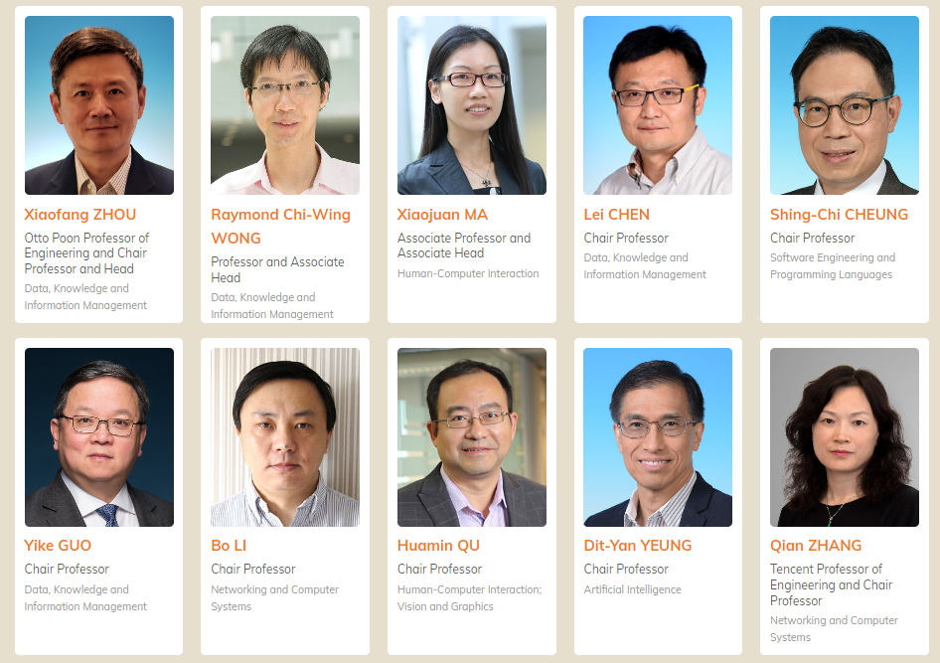
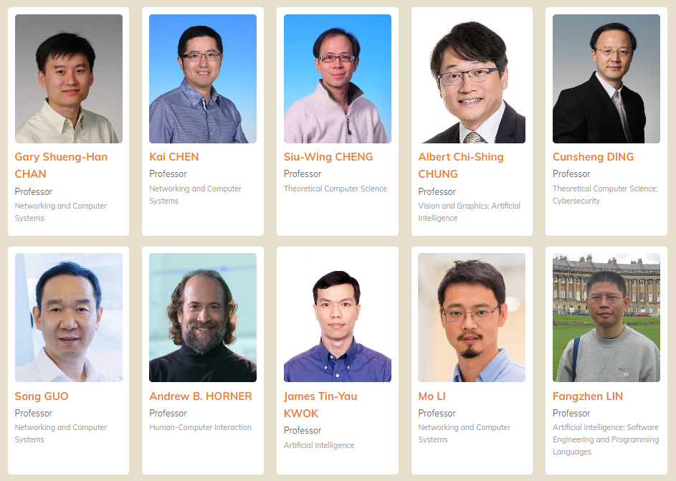
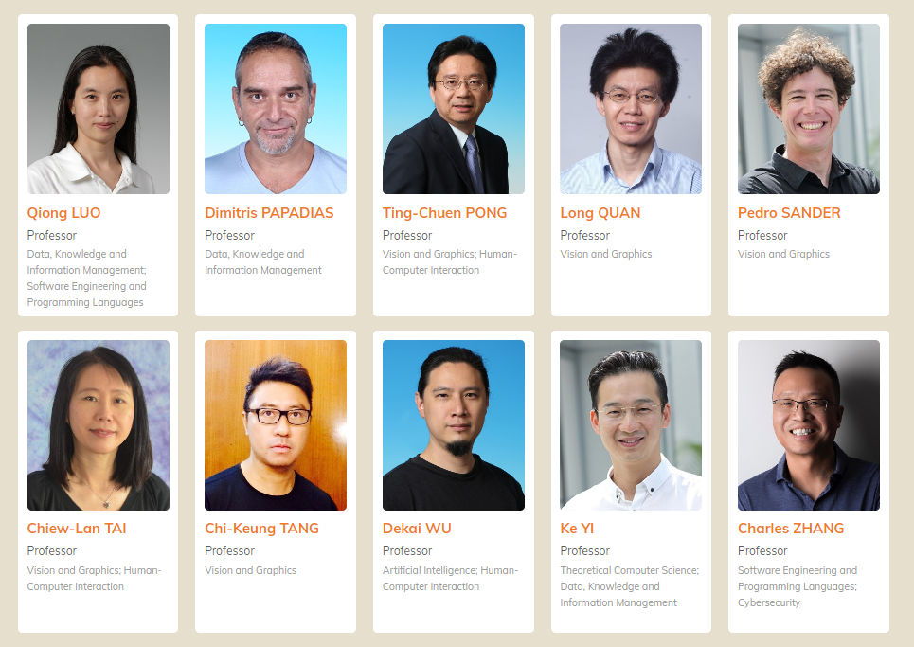
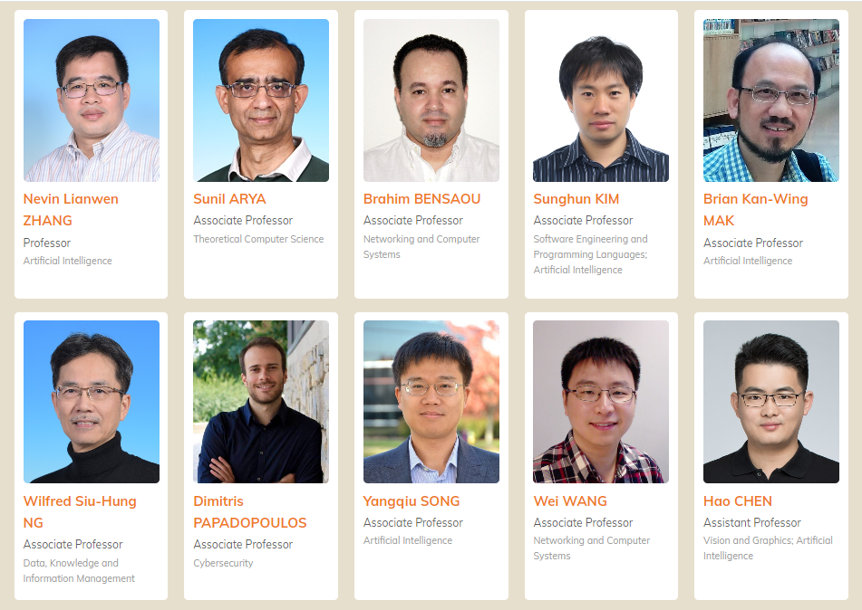
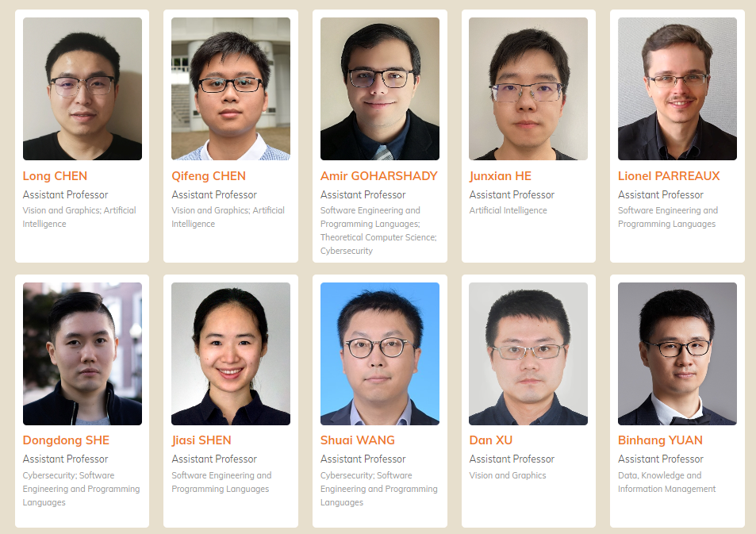
CSE Faculty
Notes:
50 faculty

Slide 6


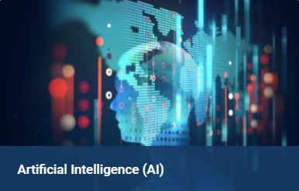

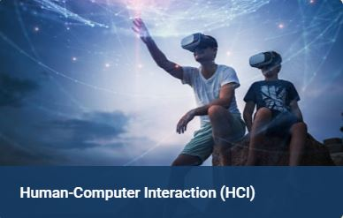


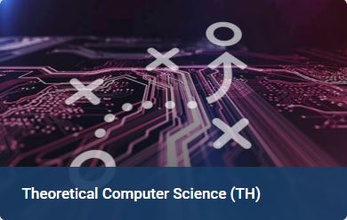

CSE Research Themes and Areas
Artificial Intelligence (AI)
Data Science (DS)
Systems (SY)
Natural Language Processing (NLP)

Slide 7

Affiliated Labs & Centers
InnoHK project on Generative AI (HKGAI)
Big Data Institute
Robotics Institute
Many industry joint labs
Notes:
InnoHK: funding and GPU serves
Joint labs: JC, HKPC, China Unicom, Huawei, Inspur, MetaX, … over 150M funding

Slide 8
HKUST CSE
UG and PG Programs
Undergraduate Programs
Postgraduate Programs
Major Programs
BEng in Computer Science (COMP)
BSc in Computer Science (COSC)
BEng in Computer Engineering (CPEG)
BSc in Data Science and Technology (DSCT)
BSc in Risk Management and Business Intelligence (RMBI)
Dual Degree Program in Technology and Management
Extended Major in Artificial Intelligence (AI)
Extended Major in Digital Media and Creative Arts (DMCA)
Additional Major(s)
Research Programs
Master of Philosophy (MPhil)
Doctor of Philosophy (PhD) Programs
Taught Programs
Master of Science (MSc) Program in Big Data Technology
Master of Science (MSc) Program in Information Technology
Minor Programs
Minor Program in Big Data Technology (for non-IT Minor students)
Minor Program in Information Technology (for non-CSE students)
(2022)

Slide 9
AI Programs
AI extended major (+AI)
BEng in AI
MSc in AI

Slide 10

Major+AI Introduced in 2021-22
Extended Major is an add-on element to enrich the existing majors
  Designed for students with fundamental knowledge in calculus, statistics and programming, but also open to other students after taking additional courses to acquire relevant foundation
Students in Major+AI are expected to gain:
  Solid knowledge in Major
  Ability to apply AI technologies to Major
Strong emphasis on practical applications and cross-disciplinary skills
Extended Major in Artificial Intelligence (Major+AI) | Division of Emerging Interdisciplinary Areas, HKUST
Notes:
We have 4 schools at HKUST: Eng, Sci, Business, Humanity and Social Sci

Slide 11
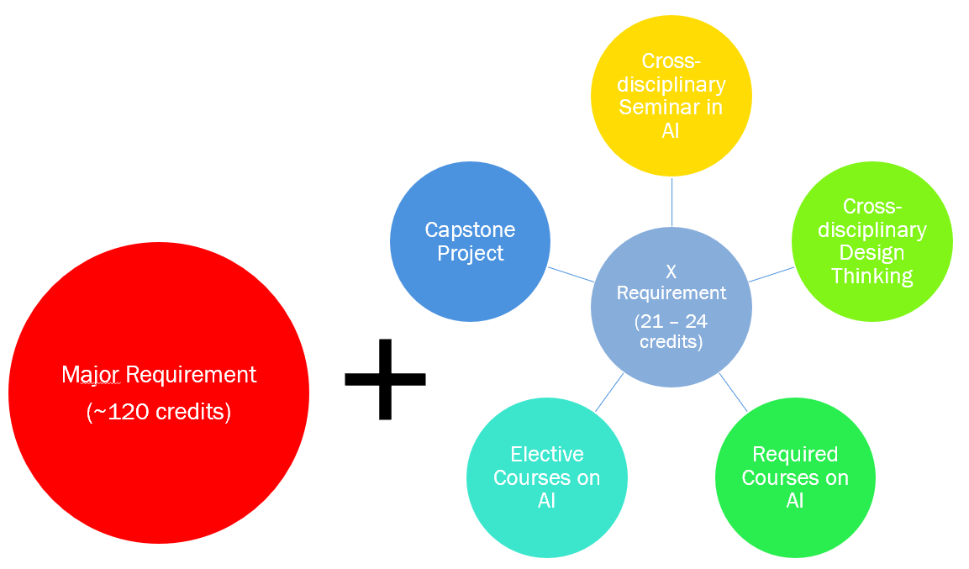
Major+AI Program Requirements
At least
12 credits
should be
single-counted
towards ‘+AI’
Notes:
As Major+AI is to add-on AI component to major programs, students need to satisfy all requirements of the major programs. In addition, they need to satisfy certain requirements for the AI component.
The AI component consists of 5 parts: Cross disciplinary seminars in AI, one course on Cross disciplinary design thinking, several required courses on AI, several elective courses on AI, and an AI-related capstone project that. The total number of required credits for the AI component is between 22–24. There is some variation here because there are requirements that you can use different courses to satisfy, and some courses have different number of credits.
Among those 22-23 credits, 12 must be singly counted toward +AI. This means that the other 10 -12 credits can be used to satisfy both the major program and the AI component.

Slide 12
Learning Journey in Major+AI?
Year 1
Year 2
Year 3
Year 4
Seminars in AI
Hands-on experience workshop in AI
Cross-disciplinary Seminar in AI
*Cross-disciplinary Design Thinking
Programming with C++
Exploring Artificial Intelligence
Machine Learning
Electives
Capstone Project
Electives
*Cross-disciplinary Design Thinking

Slide 13
Our Experiences
Highly successful
  20% students admitted to School of Engineering are in +AI
  +AI gets better students
Things to improve:
  Need to introduce a year-one AI course
    Programming skills can be a problem (partly due to the current school-based admission system)
  +AI for CS-based programs (COMP, COSC, CPEG, DSCT…)

Slide 14
AI Programs
AI extended major (+AI)
BEng in AI (Proposal)
MSc in AI (Proposal)

Slide 15
Motivation
CSE plans to offer B.Eng. in Artificial Intelligence to
  Address the increasing industry demand and shortage of skilled AI professionals
  Foster interdisciplinary collaboration
  Advance AI research
  Help University/School/Department to recruit elite students

Slide 16
Admission and Quota
Host: Department of Computer Science and Engineering
Effective Cohort: Student cohort of 2025-2026
Quota: 100 (Quota for COMP will be adjusted to 100 accordingly)
Admission Methods
Program-based admission (50%)
School-based admission (50%)
JUPAS box for program-based admission, information day, etc.
Quota and Admission Methods are tentative, subject to discussion and approval
Notes:
JUPAS: Joint University Programmes Admissions System.

Slide 17
Stakeholder Survey
The survey result shows a capacity of 143 respondents
It covers a good mixture of industry partners, CSE alumni, undergraduate and postgraduate students
To industrial Partner
Q1: Would you be interested in hiring university graduates with undergraduate major in Artificial Intelligence?
Q2: Would you prefer to hire graduate with major in Artificial Intelligence major than Computer Science and Engineering?
Q3: What AI tracks or specializations would you be interested in / useful in your company?
To CSE alumni, current undergraduate and postgraduate students
Q1: Would you be interested in taking an undergraduate major in Artificial Intelligence if you were high school student or freshman, and were about to choose your major in the university?
Q2:Would you prefer to choose major in Artificial Intelligence than major in Computer Science and Engineering?
Q3: What AI tracks or specializations would you be interested to learn?
Notes:
JUPAS: Joint University Programmes Admissions System.

Slide 18
Key Findings
Strong Interest in AI Education
A significant majority of respondents (78%) expressed interest in AI education, indicating a strong demand for AI-related courses and programs.
Many industry partners expressed a willingness to hire graduates with an AI major, highlighting the potential for enhanced employability and career growth for students specializing in AI.
Preference in both AI major and COMP major
While there is a strong interest in Artificial Intelligence, many stakeholders still value a comprehensive and well-rounded Computer Science education.
Some respondents noted that while AI knowledge would be an advantage, a broader Computer Science background could provide more flexibility and opportunities in the job market.
Stakeholders are interested in a diverse range of applications and specializations, with a strong emphasis on practical, real-world applications
The most popular AI specializations among respondents are Generative AI (77%), Computer Vision (65%), Natural Language Processing (65%), and NLP for chatbots and customer service (49%).

Slide 19
Benchmark
Locally and Internationally
CMU (B.S. In Artificial Intelligence)
MIT (B.S. In Artificial Intelligence and Decision Making)
CUHK (B.Eng. in Artificial Intelligence: Systems and Technologies (AISTN))
HKU (Bachelor of Arts and Sciences in Applied Artificial Intelligence)
PolyU (BEng(Hons)/BSc(Hons) Scheme in Information and Artificial Intelligence Engineering (Internet of-Things/Artificial Intelligence/Information Security)
  BSc(Hons) in Artificial Intelligence and Information Engineering
PolyU (BSC(Hons) Scheme in Computing and AI (Computer Science / Financial Technology and Artificial Intelligence / Enterprise Information Systems)
  BSc(Hons) in Financial Technology and Artificial Intelligence
PolyU (Bachelor of Artificial Intelligence and Data Analytics (Secondary Major))
HKUST (GZ) (B.Eng. in Artificial Intelligence)
Notes:
https://www.jupas.edu.hk/en/programme/hku/JS6224/
https://saasweb.hku.hk/programme/ai.php
https://www.jupas.edu.hk/en/programme/cuhk/JS4468/
https://www.cse.cuhk.edu.hk/admission/aistn/
https://www.cse.cuhk.edu.hk/wp-content/uploads/admission/AIST2023.pdf
https://www.jupas.edu.hk/en/programme/polyu/JS3868/
https://www.jupas.edu.hk/en/programme/polyu/JS3180/
https://www.jupas.edu.hk/en/programme/cuhk/JS4412/

Slide 20
Key Findings: Comparison HKU & CUHK
HKU AI program is Bachelor of Arts and Sciences, under Department of Statistics and Actuarial Science
  The program offers concentration of AI Technology, AI in Business and Finance, AI in Medicine, AI in Smart City, AI in Neurocognitive Science and Other Elective Courses
  But for each concentration usually it has only 5-7 courses to choose
  For the overall curriculum, most of the elective courses are non-COMP courses
CUHK AI program is B.Eng. with specification in Systems and Technologies
  It focuses on the system side of the AI technology
  The program offers streams in Biomedical Intelligence, Intelligent Multimedia Processing, Large-scale Artificial Intelligence – Theory and Systems, and Intelligent Manufacturing and Robotics and a non-stream in General Artificial Intelligence: Systems and Technologies
HKU and CUHK tend to brand their AI programs to be ‘elite’ and small, with concentration
  HKU JS6224 2023 total offer vs. application: 25 vs. 613
  CUHK JS4468 2023 total offer vs. application: 35 vs. 1258

Slide 21
Key Findings: Comparison PolyU
PolyU offers many AI programs. But they are one of the major choices under scheme-based admission
  JS3180 BEng (Hons)/BSc (Hons) Scheme in Information and Artificial Intelligence Engineering (Internet-of-Things / Artificial Intelligence / Information Security)
    Students are allowed to enrol in any programme without being subject to further assessment
  For BSc (Hons) in Artificial Intelligence and Information Engineering, the structure is like the EE curriculum where some EE courses have ML, Data Science and AI courses
  JS3868 BSc (Hons) Scheme in Computing and AI (Computer Science / Financial Technology and Artificial Intelligence / Enterprise Information Systems)
    Students will receive one award upon successful completion of the graduation requirements
  For BSc in Financial Technology and Artificial Intelligence, the courses are very similar to a traditional COMP major with some 4000-level electives in Finance. The curriculum doesn’t really reflect a strong emphasis in AI.

Slide 22
Key Findings: Curriculum Design
Most AI curriculums (internationally and locally) include (1) Math foundation, (2) Computer Science foundation, (3) AI and Machine Learning foundation, and (4) AI elective
AI electives are usually grouped as a list of area of specializations
  CMU and MIT require ‘breadth’, e.g., one elective from each area
  Local curriculums require ‘depth’, e.g., one stream/concentration
Final Year Project (FYP) is a compulsory component only for local B.Eng. AI program

Slide 23
CSE AI Program Features
A ‘general’ AI program to attract and nurture elite local JUPAS applicants
Large admission quota
Build up solid foundation knowledge in Mathematics, Computer Science, Artificial Intelligence and Machine Learning
Students can freely choose to explore depth or width of AI specifications
Emphasize the industrial needs and keep the curriculum/courses up-to-date

Slide 24

AI Curriculum Overview
CAPSTONE
PROJECT
INTERNSHIP
COMPUTER
SCIENCE
CORE
AI and COMP
ELECTIVES
ARTIFICIAL
INTELLIGENCE
CORE
MATH
STATISTIC
CORE
ENGINEERING
FUNDERMENTALS
UNIVERSITY
COMMON
CORE

Slide 25
Study Pathway Overview
4
Final Year Project/Thesis
Major Electives
University Common Core (Languages, CC)
3
Major Electives
AI Core
Free Electives
120
Credits
2
MATH Core
CS Core
(30 Credits)
1
Engineering
Fundamentals
(18 credits)
AI Ethics
Exploring AI
Required credits for Major Required Courses and Electives 65 credits

Slide 26
AI Curriculum Core Courses
Math and Statistics Core 15 – 19 credits | Computer Science Core 15 - 18 credits | Artificial Intelligence Core 18 credits | Ethics Core 3 credits | AI Electives 18 credits
Calculus (4-7) MATH1012/1013/1023 and MATH1014/MATH1024; Or MATH1024 | Introduction to Computer Science (3) COMP1021 | Exploring AI (3) COMP2211 (revamp) | AI Ethics COMP1944 | 4 AI electives + 2 other COMP electives Revamp existing courses Add new courses
Algebra (3-4) MATH2111 Or MATH2121 Or MATH2131 | Programming and Data Structure (5-8) COMP2011 and COMP2012; Or COMP2012H | Fundamentals of Artificial Intelligence (3) COMP3211 (revamp)
Statistics (4) MATH2411 | Computer Organization (4) COMP2611 | Machine Learning (3) COMP4211 (revamp)
Discrete Math Tools for Computer Science (4) COMP2711 | Design and Analysis of Algorithm (3) COMP3711 | Natural Language Processing or Vision (3) COMP4221/COMP4471
 |  | AI FYP (6) + LANG4030 (3) AI Internship

Slide 27
Study Pathway Details
S / Y4
AI Elective
FYP/T
COMP
4981/H
Univ.
Common
Core
Acad. &
Prof.
Dev
COMP
4900
F / Y4
AI Elective
S / Y3
NLP/Vision
COMP4221/
4471
Machine
Learning
COMP4211
AI Elective
Eng.
Seminar
Series
ENGG
2010
F / Y3
Algorithm
COMP3711
Fundam. of
AI
COMP3211
AI Elective
S / Y2
Applied
Statistics
MATH2411
OOP and
Data Structure
COMP2012
Computer
Organization
COMP2611
F / Y2
Linear Algebra
MATH2121
Programming
with C++
COMP2011
Discrete
Math
COMP2711
Tech.
Comm. I
LANG2030
S / Y1
Calculus II
MATH1014
Exploring AI
CMP2211
LANG1401/1402
F / Y1
Calculus I
MATH1012/
1013
Intro to CS
COMP1021
ENGG
Intro
AI Ethics
CMP1944

Slide 28
B.Eng. COMP vs. B.Eng. AI
 | BEng in Computer Science | BEng in Artificial Intelligence
Math Core | MATH/COMP (Calculus, Algebra, Discrete Math, Statistics) | Remove ELEC2600/H, IEDA2520/2540, MATH2421, MATH2431 choices in Statistics
Computer Science Core | 7 Required Courses | Remove COMP3111 Software Engineering Remove COMP3511 Operating System 5 Required Courses
Artificial Intelligence Core (18 credits) | N/A | Add COMP1944 Artificial Intelligence Ethics Add COMP2211 Exploring Artificial Intelligence Add COMP3211 Fundamentals of Artificial Intelligence Add COMP4211 Machine Learning Add COMP4221/COMP4471 Introduction to Natural Language Processing/Deep Learning in Computer Vision 5 Required Courses
Area Electives (18 credits) | 1 COMP2000-level or above elective 5 COMP electives from the specified elective list, with at least three taken from 1 area and at least two outside that area Artificial Intelligence/Theory Vision & Graphics/Multimedia Software/Database Computer Systems/Networking Courses without Associated Area | 4 AI electives and 2 other-COMP electives, all are 3000-level or above

Slide 29
Still Many Details to Work Out
Arrangements of Extended Major in AI
Arrangements with dual degrees
Study pathways
Course details and arrangement
Resources: faculty, GPUs, student support, admin…

Slide 30
Current vs. Future
Current No. of COMP students per year: ~160
(2024-25 Cohort prediction: ~180)
2025-26 Cohort: ~200 (20 additional students)
No. of COMP students per year: 100
No. of AI students per year: 100
Notes:
Program vs school-based admission
How to manage multiple JUPAS boxes

Slide 31
AI Programs
AI extended major (+AI)
BEng in AI (Proposal)
MSc in AI (Proposal)

Slide 32
Background
AI has become a key driver of innovation and growth in many industries
CSE has already been offering more AI and related courses in our UG, RPg and TPg programs
High demand for a new MSc program specialized in AI, especially its recent developments, to equip graduates with advanced skills and the latest knowledge in AI

Slide 33
Similar TPg Programs Elsewhere
A comprehensive survey was conducted to include similar programs in HK, Mainland China, Singapore, USA and UK
All existing MSc programs offered by other local universities only partially cover AI, regardless of what their program titles are
There is room to create a high-quality MSc program in AI to meet the growing needs of the rapid development of AI
Our program is closer in spirit to the MS in Machine Learning program of CMU

Slide 34
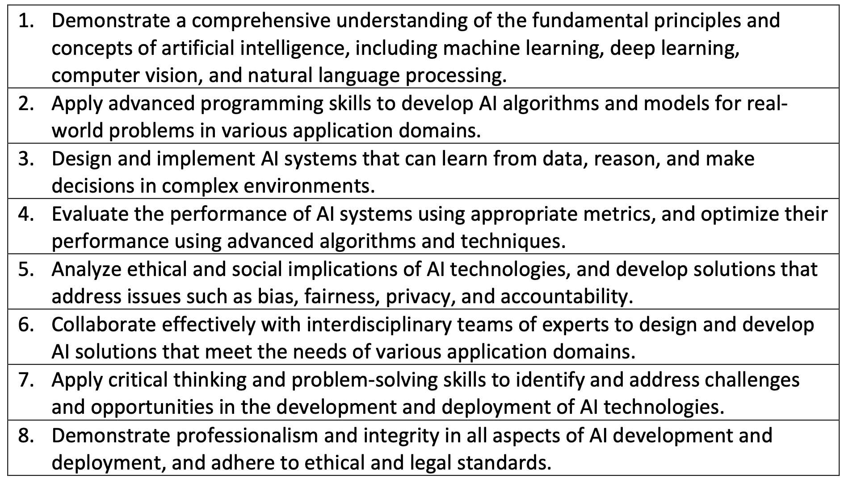
Program Learning Outcomes

Slide 35
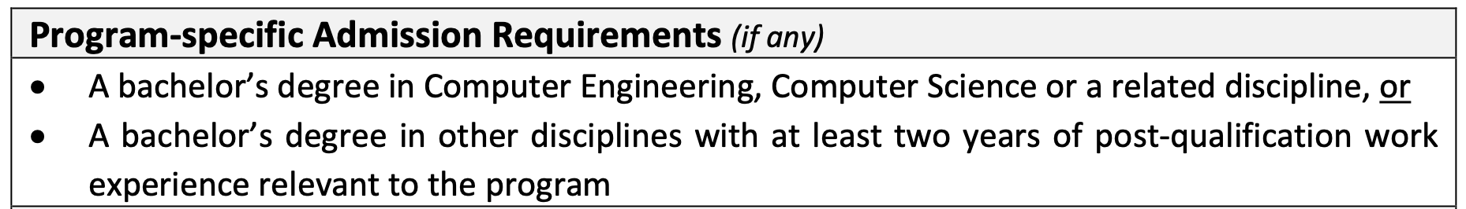
Admission Requirements

Slide 36
Curriculum

Slide 37
Curriculum (2)

Slide 38
Curriculum (3)

Slide 39
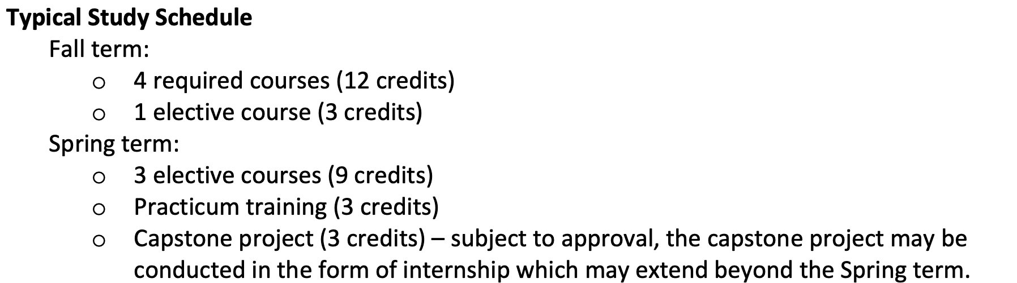
Curriculum (4)

Slide 40
Summary
A highly successful introduction of Major+AI in 2021
A new BEng in AI will be introduced in 2025
  BEng in CSE size reduced
  +AI option removed for CS-related programs
A new MSc in AI will be introduced in 2025
  Together with MSc in IT (with a new concentration in Cybersecurity), and MSc in Big Data
It is important to keep both CS and AI programs as first-class programs

