Slide 1
CS Ethics in the Age of AI H V Jagadish Michigan Institute for Data & AI in Society University of Michigan
Supported in part by NSF grants 2106176 and 2312931
© H. V. Jagadish 2025

Slide 2
What to teach CS Students?
Let’s look at accreditation of undergraduate programs.
Professionalism and Ethics has long been a required topic.

Slide 3
CSAB/ABET
Recognize professional responsibilities and make informed judgments in computing practice based on legal and ethical principles

Slide 4
Professionalism and Ethics
=> Copying software is bad
=> How patents work
### These things matter, but the big issues are elsewhere

Slide 5
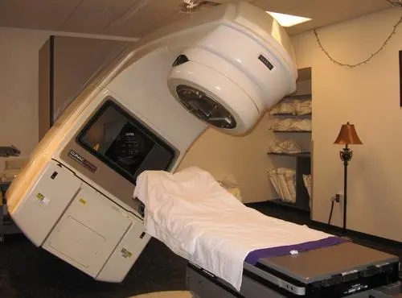
Therac 25 (1985-1987)
Software bug killed patients with 100x radiation

Slide 6
Ariane 5 (1999)
Rocket launch failed at a cost > 2B RMB

Slide 7
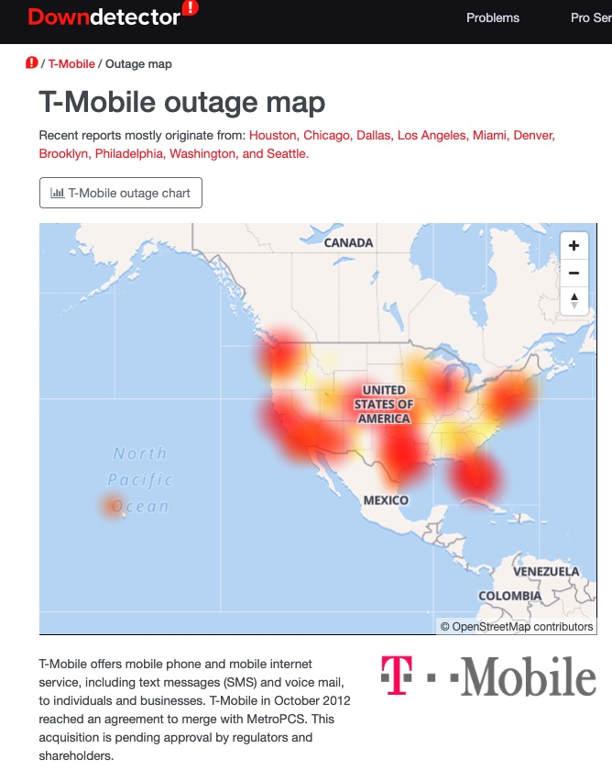
T-Mobile (2020)
Many hours of network outage across most of USA for a major cellphone service company

Slide 8
Have to Make Code Free of Bugs
Obviously, and this is a very important issue.
We teach:
better debugging
principles of software engineering
…
Not an issue of ethics

Slide 9
Data and AI Change the Picture
Huge potential impacts in all areas of life
Many ways things could go wrong, even when the system works as designed.
(I will not discuss privacy loss due to data stolen from hacked systems)

Slide 10
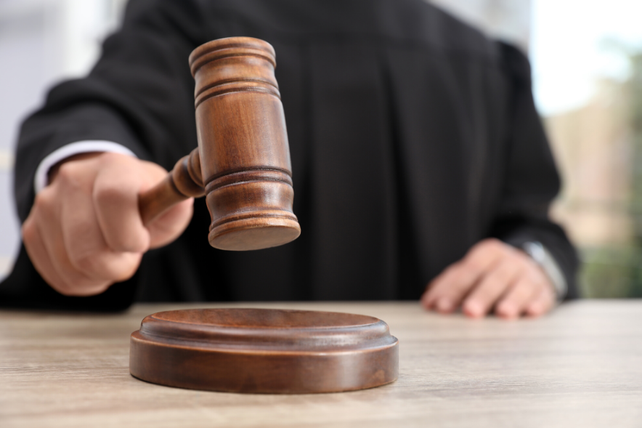
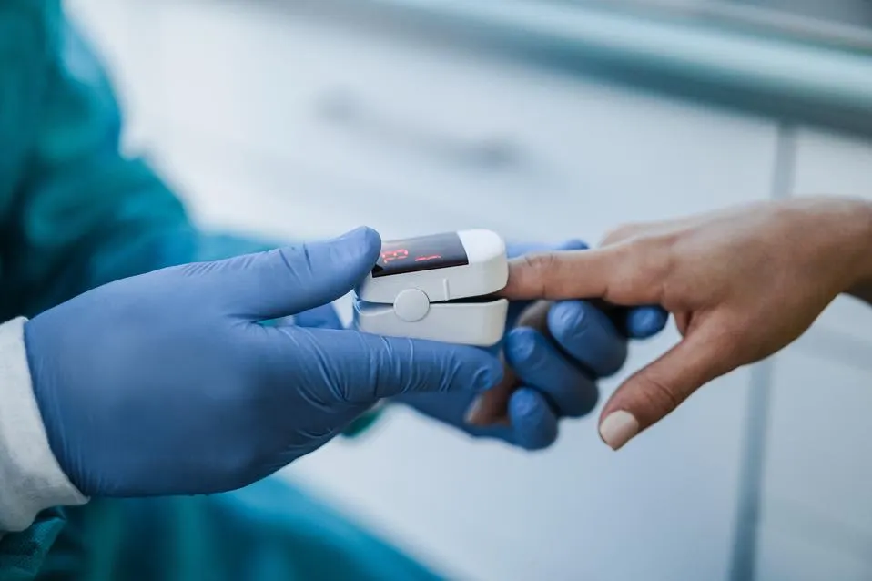
Decision-making algorithms in everyday life
Algorithmic hiring
College admission
Loan approval
And many more …
Crime prediction
Healthcare diagnosis

Slide 11
Data Science
AI
Big Data

Slide 12
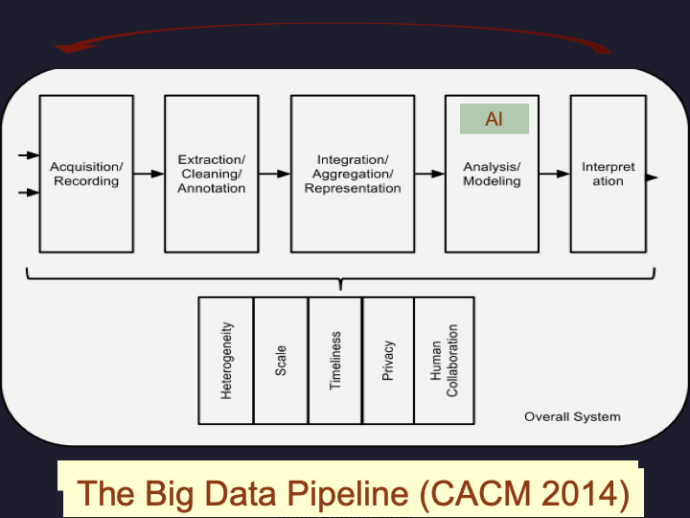

Slide 13
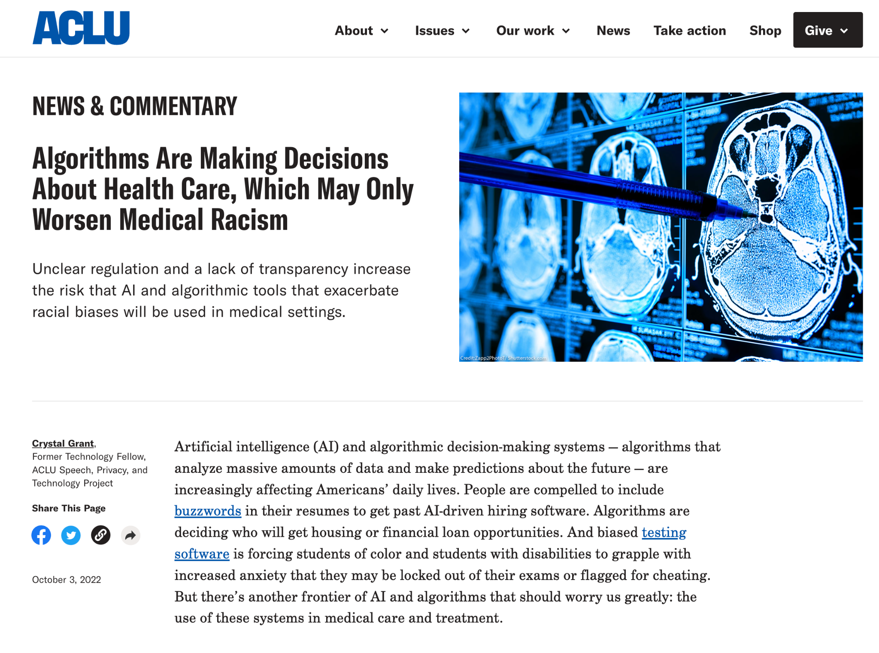
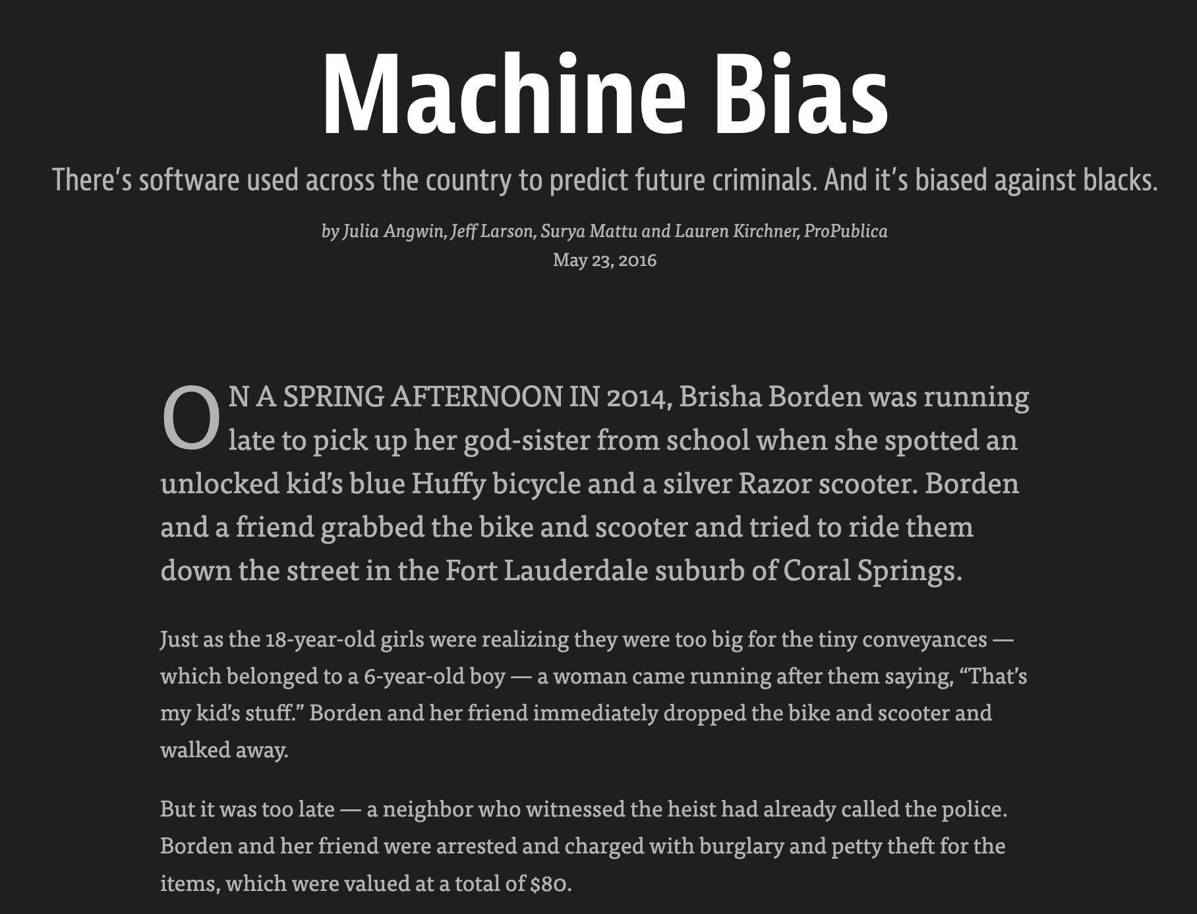
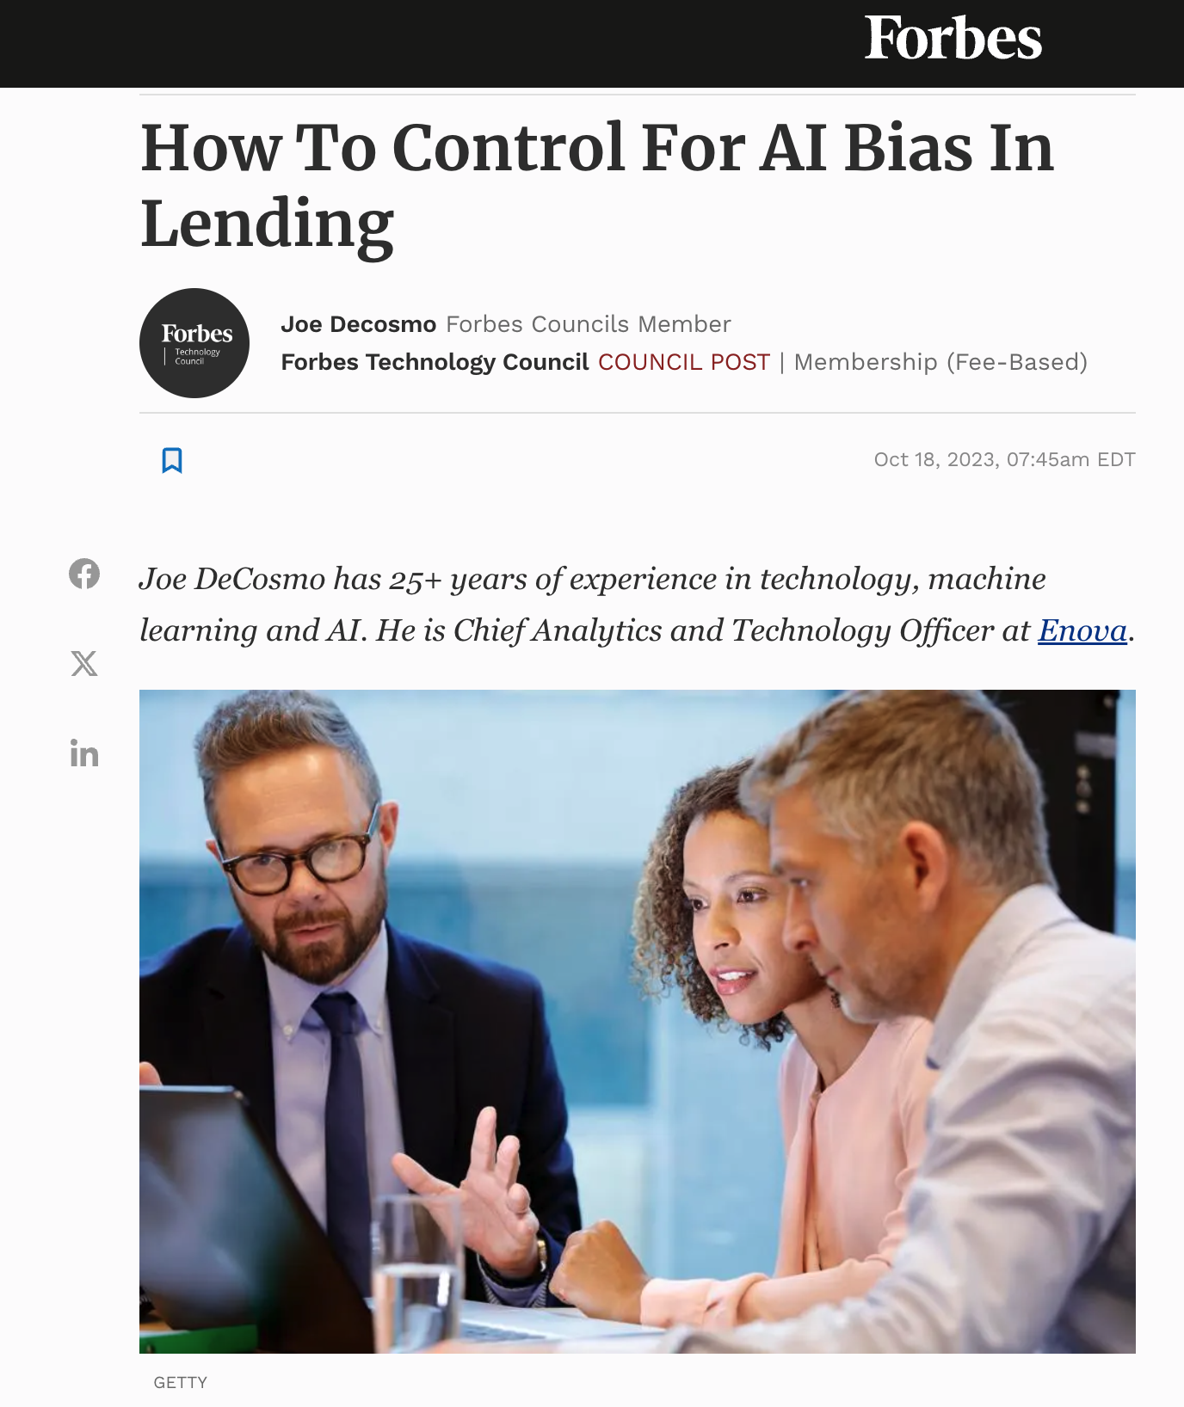
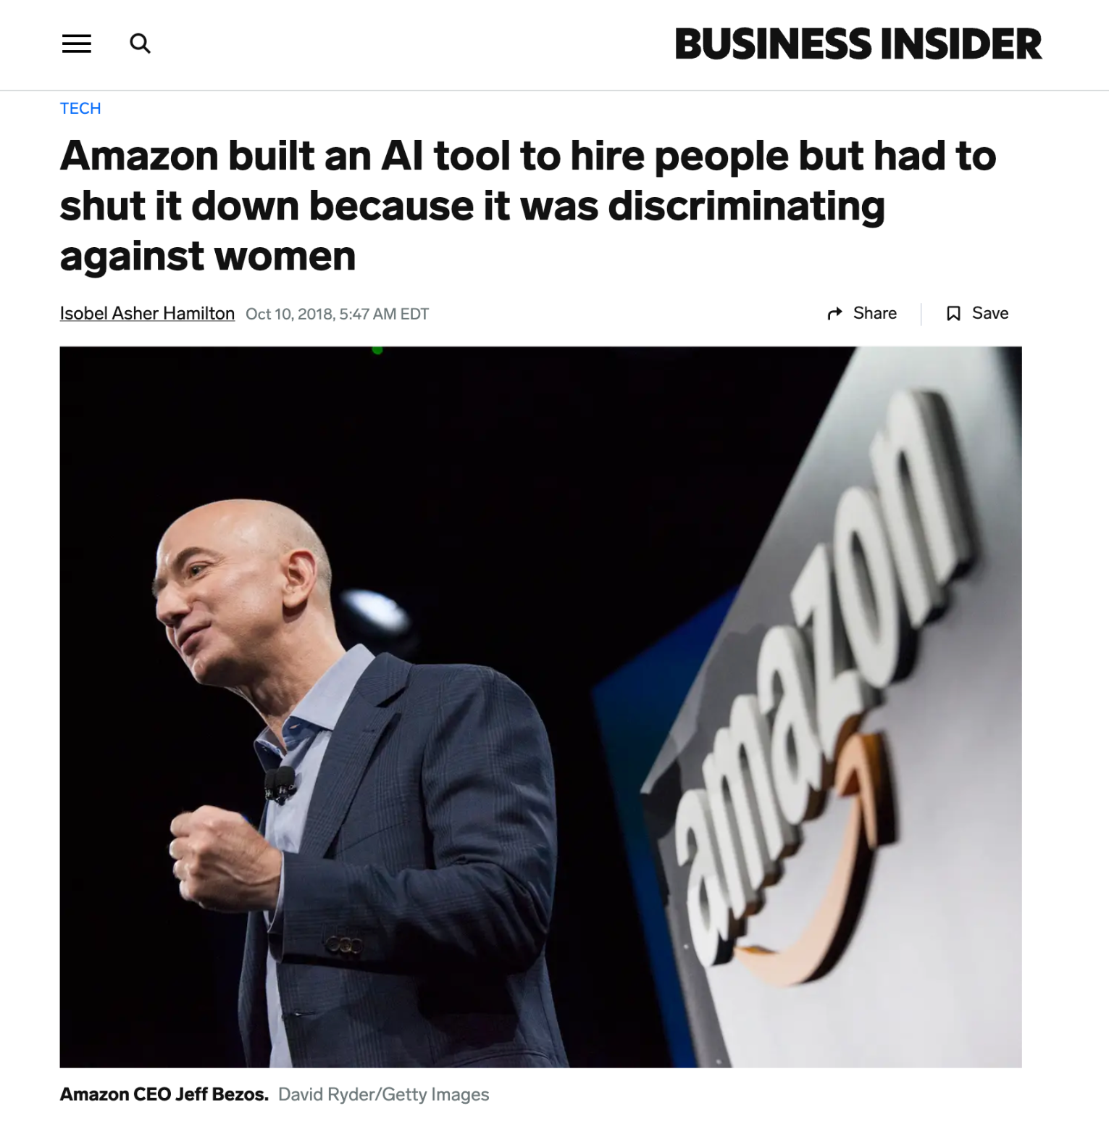
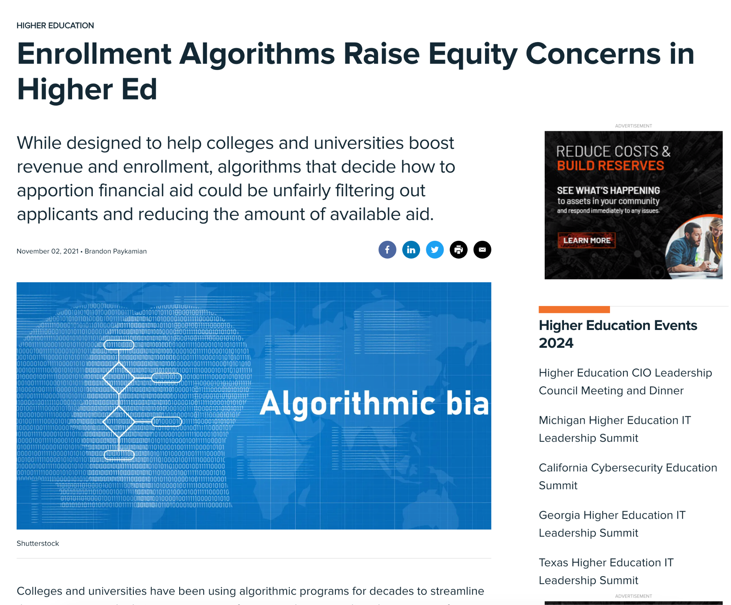
Concerns about algorithmic fairness
https://www.businessinsider.com/amazon-built-ai-to-hire-people-discriminated-against-women-2018-10
https://www.govtech.com/education/higher-ed/enrollment-algorithms-raise-equity-concerns-in-higher-ed
https://www.forbes.com/sites/forbestechcouncil/2023/10/18/how-to-control-for-ai-bias-in-lending/?sh=f717a6149262
https://www.propublica.org/article/machine-bias-risk-assessments-in-criminal-sentencing
https://www.aclu.org/news/privacy-technology/algorithms-in-health-care-may-worsen-medical-racism

Slide 14
What is in the Training Data
Is there enough representation of minority groups in the data to be able to be able to perform the downstream AI task as well as for the rest of the population?

Slide 15
Facebook Thinks Some Native American Names Are Inauthentic
Dana Lone Hill, who is Lakota, … wrote … that Facebook told her her name was not “authentic” when she attempted to log in

Slide 16
Equity
Treat entities (differently)
based on their circumstances
to achieve comparable “assessment” conditions.

Slide 17
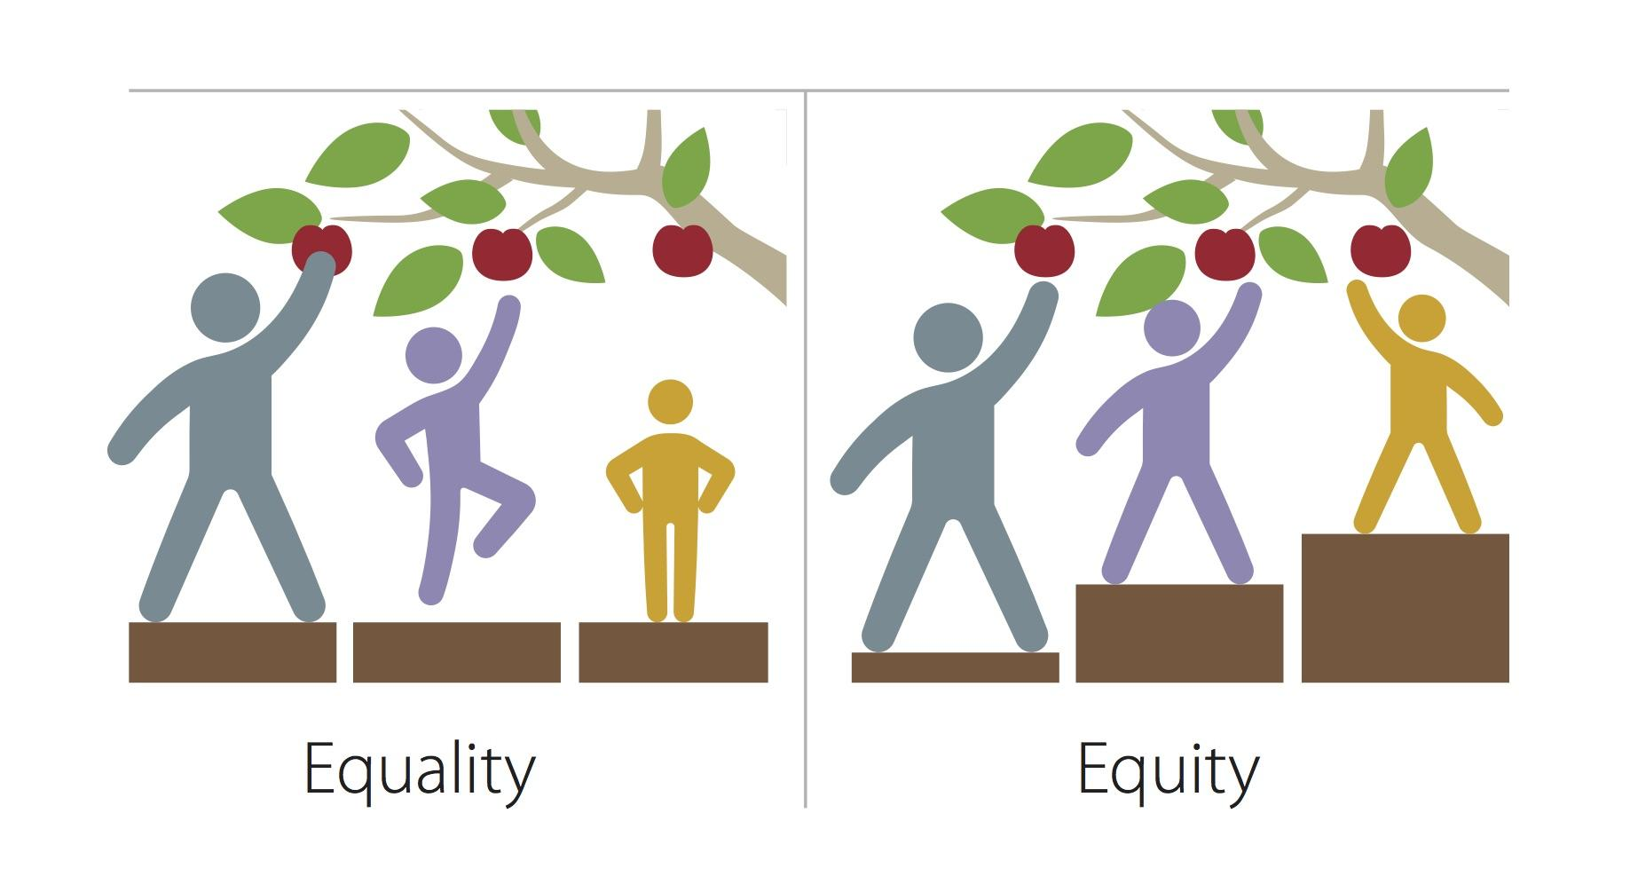
Fairness
Equity
MPCA Photos, pexels.com, CC-BY-NC 2.0

Slide 18
Equity Example
It is fair to give each student in the class an equal amount of time to take an exam.
Equity requires allowing extra time for some students.

Slide 19
Insufficient data coverage
AsudehICDE19
LinVLDB20
What are the largest underrepresented regions in the dataset?
Maximal Uncovered patterns!
Other possible value assignments
…
Suburban
Aged > 60
Female
Uncovered!
COUNT(female from suburban area) < τ (threshold)
Female aged >60
Female from suburban area
Male from suburban area
aged over 60
Female from suburban area
aged over 60
Pattern graph: all possible value combinations.
orange: uncovered patterns
grey: covered patterns
Protected attributes: age, gender, race, poverty…
Asudeh et al., ICDE, 2019,
Lin et al., VLDB, 2020
Notes:
Underrepresentation has been identified as a potential cause of discrimination against minority groups. For instance, high-tech tools may inadvertently discriminate against the poor due to lower data coverage resulting from their limited usage.
(!) Our research focuses on identifying the most significant underrepresented regions in the collected datasets. Consider a set of protected attributes, such as age, gender, and race, and view all possible combinations of attribute values as a pattern graph. Each pattern in this graph represents an ethical group. If a group's count falls below a specified threshold, it is deemed uncovered. Our goal is to traverses the pattern graph to evaluate the coverage of each pattern, identifying the maximal uncovered patterns in the intersectional space.
Additionally, algorithms have been proposed to address these maximal uncovered patterns and extend our identification process to multi-relational scenarios, providing a more comprehensive solution to mitigating underrepresentation and potential discrimination in datasets.

Slide 20
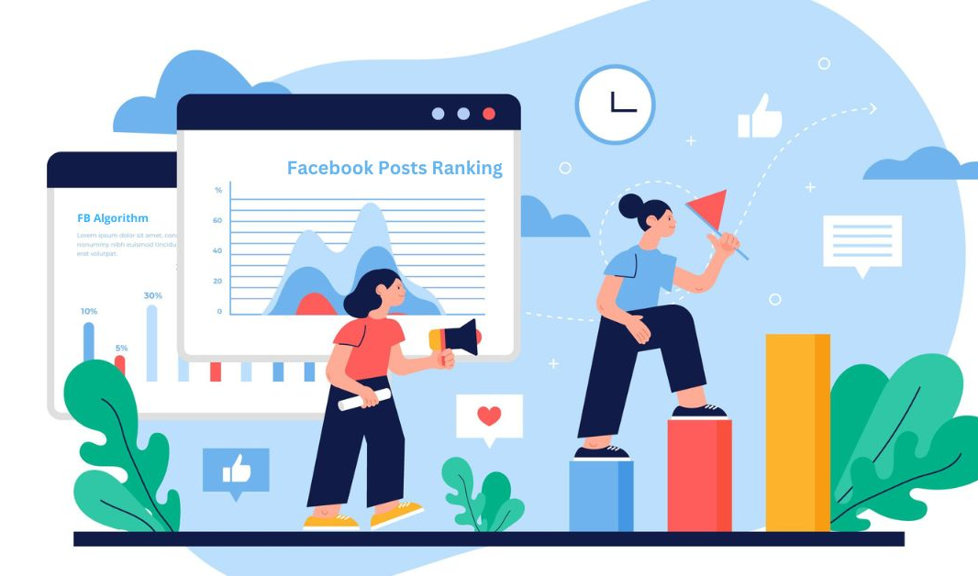
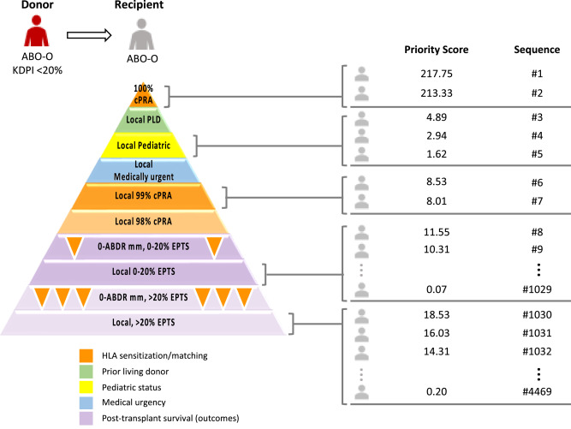
Ranking in everyday life
Education: college admission
Job market: employee hiring
Healthcare: organ transplant list
Social media: user feed

Slide 21
Which minority groups?
Historically marginalized demographic groups
Race
Gender
…
Could there be other groups? What does the data say?
Education level
Rural/urban
…
What about intersectionality?

Slide 22
Facets of Data Equity
 | Age | Job | … | …
Ana | 25 | Painter
Bing | 37 | Clerk
Carol | 42 | Judge
Dinesh | 22 | Pianist
Ellie | 16 | Student
Farhad | 75 | Retired
Representation Equity

Slide 23
Facets of Data Equity
 | Age | Job | … | …
Ana | 25 | Painter
Bing | 37 | Clerk
Carol | 42 | Judge
Dinesh | 22 | Pianist
Ellie | 16 | Student
Farhad | 75 | Retired
Representation Equity
Feature Equity

Slide 24
Facets of Data Equity
 | Age | Job | … | …
Ana | 25 | Painter
Bing | 37 | Clerk
Carol | 42 | Judge
Dinesh | 22 | Pianist
Ellie | 16 | Student
Farhad | 75 | Retired
Representation Equity
Feature Equity
Access Equity

Slide 25
Rights of a Data Subject
Data subjects should be able to:
See what data is collected about them
Contest errors in the data and have them corrected
Understand what the data says (not be misled)

Slide 26
Access is needed for recourse
Do you know why you were denied a loan?
Are you sure the bank didn’t consider some spurious data?

Slide 27
But Access is not Enough
Access has to be user-appropriate
The Accessed Resource has to be Usable
SIGMOD07

Slide 28
Data Ownership
Every action can be recorded as data.
Who has that data and what can they do with it?
Asymmetry between individuals (e.g. customers) and big companies.
More data => More power

Slide 29
Cambridge Analytica App
Your preferences can be predicted by the app, better than by your roommate, based on 70 ”like”s on Facebook. (Better than your spouse with 300 “like”s).
Once someone has such a powerful app, they really know you, and can “push your buttons”.

Slide 30
What do we measure?
Rarely can get exactly the data we want.
Have to live with surrogates.
Have to understand how surrogates differ from what we really want.
E.g. Analyze social media to understand public opinion.
E.g. Past medical expenses as metric of a person’s overall health.

Slide 31
AI works with a Model of the World
Model is a simplification:
Leaves out a great deal.
How do we choose what to include in the model and what to leave out?
Controversy around use of standardized test scores for college admission.
Simple models (e.g. linear regression) we can see and understand exactly how the model works.
AI models can have billions of parameters, and their working beyond human comprehension, but same black-box testing principles apply.

Slide 32
Ethics has to be taught has part of Computer Science Education

Slide 33
How To Teach Ethics
Stand-alone required class not effective
Too little, too late
Disconnected from “regular” CS
Integrating into regular teaching is hard
Already too much material too cover!!
Needs support structure

Slide 34
The Support Structure Needed for Ethics
Knowledge of societal issues
Ethical Reasoning
Action

Slide 35
“Back Story” for Regular Assignment
Programming assignment to add and delete objects from a linked list
Student is asked to hire some employees and then fire some employees
For each employee, choose and record name and gender
More male employees than female employees
Male employees hired earlier and fired later, on average
Robust finding in every class year after year
Takes under 10 minutes of lecture time

Slide 36
Data Science Ethics
Please visit:
https://www.edx.org/course/data-science-ethics-michiganx-ds101x
Or search “Data Science Ethics” on Coursera or EdX
Earliest course on Ethics of Data Science and AI.

