Slide 1
A bold vision for future higher education
Dr. Ping Ji
http://ping-ji.com

Slide 2
CUNY
Largest public univ. system in US
~ 230,000 degree-seeking
~ 220,000 continuing ed
~ 50,000 degrees awarded each year
25 institutions
11 senior, 7 community, 6 professional
Ph.D. granting CUNY Graduate Center
Student Demographics
42% from households < $20,000 in income
>20% of CUNY student is from each ethnic group of Asian, Black, Hispanic and White
CUNY Graduate Center researchers are active educators
75% PhD students funding from teaching at CUNY colleges
95% CS doctoral research faculty are from non-GC CUNY colleges
“… the City University of New York system propelled almost six times as many low-income students into the middle class and beyond as all eight Ivy League campuses, plus Duke, MIT, Stanford & Chicago combined.” – the New York Times, Jan. 2017

Slide 3
Current (US) Education System
Long History of US Higher Ed
Harvard 1636, W&M 1693, Yale 1701, …
City College of New York 1847 → City University of New York 1960
Structured Curriculum (e.g. CUNY)
30 credits common core + 30 credits major for Associate degree
120 credits for Bachelor degree
Structured class hours and learning outcomes for everyone
Course based pre-requisite knowledge
Education boards approved learning goals

Slide 4
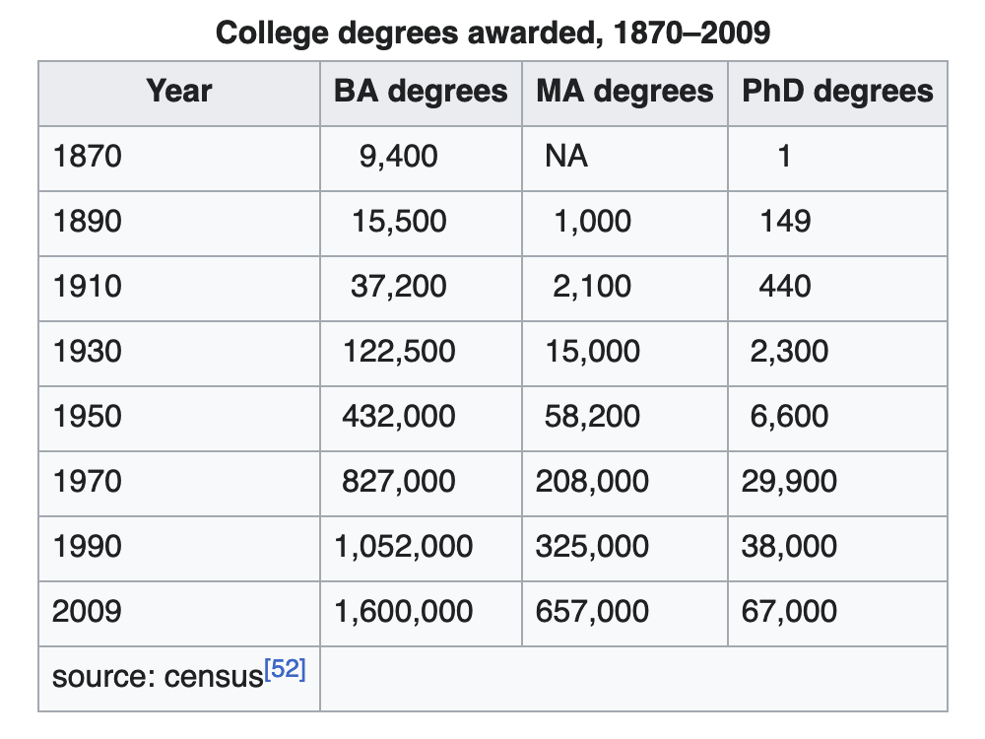
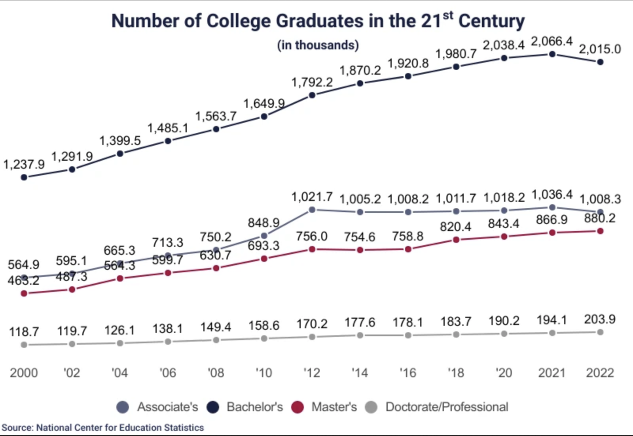
Total # of Bachelor’s degrees ~2million, class 2022
Total # of BA in Comp. & Info Science 112,720, class 2023 [nsc]
Ref: [nsc] https://nscresearchcenter.org/undergraduate-degree-earners/
Notes:
[1] https://nscresearchcenter.org/undergraduate-degree-earners/
[2] https://cybersecurityventures.com/jobs/
[3] https://www.indeed.com/career-advice/finding-a-job/how-many-jobs-are-available-in-cyber-security

Slide 5
e.g. cybersecurity field:
3.5 million unfilled cybersecurity jobs, Apr. 23 report [ccm23]
19,500 new jobs in cybersecurity EACH year for the next decade, [indeed24]
Ref:
[ccm23]: cybercrime magazine, 2023; [indeed24]: indeed.com, 2024
Notes:
[2] https://cybersecurityventures.com/jobs/
[3] https://www.indeed.com/career-advice/finding-a-job/how-many-jobs-are-available-in-cyber-security

Slide 6
Widening gap between education outcome and industry demand
Need a ground-breaking change in education for workforce development

Slide 7
Attainable eDucation for All (AeDA)
Employers
TALENT
RESOURCES
Evaluation
Orgs
Education
Entities

Slide 8
e.g. cyber security
Health Care
Finance
Information Technology
……
Government
Civil Engineer
Advanced Training
Network Security
ML, ethics, legal
……
……
System programing
& Security
Computer
Networks

Slide 9
AI’s role in Education
Precise Training
Promote efficient knowledge acquisition with minimal redundancy
Address key gaps in current educational tools and practices
Better Learning
Reduce frustration caused by recursive training
Enhance engagement through flexible, adaptive learning system
Improve diversity, equity and inclusion in education
A 40+ years of effort! Time for better realization.

Slide 10
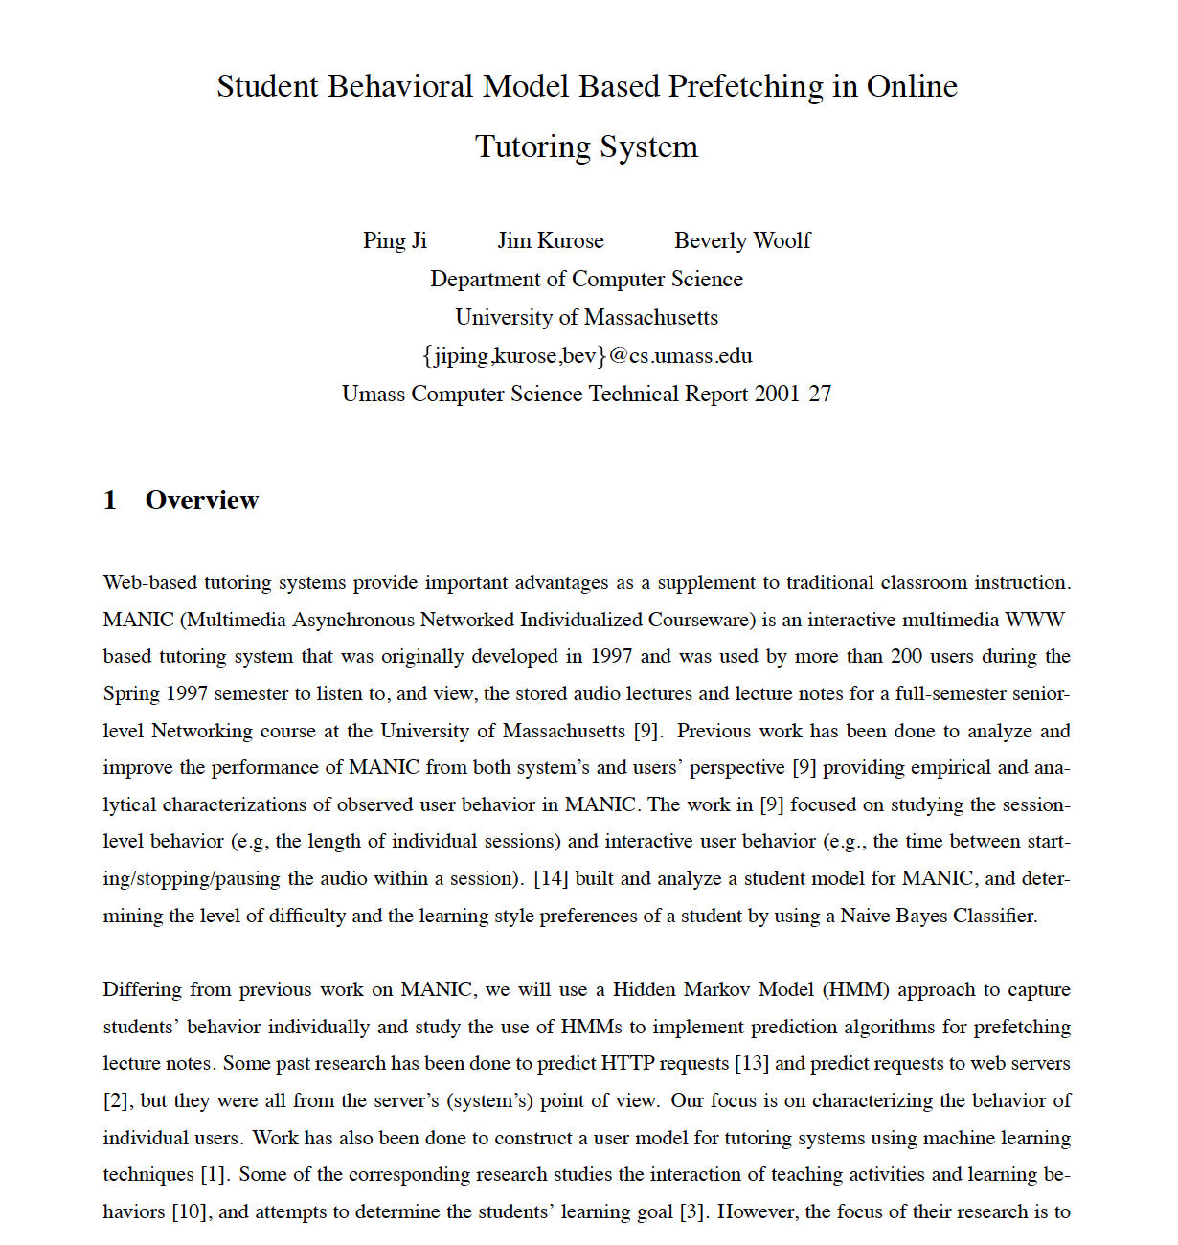
An Old Day’s Work
Student Behavioral Model Based Prefetching in Online Tutoring System
Understand user accessing behavior to an online tutoring system (MANIC)
Time series modeling – HMM
Improve system performance based on predictions of user access

Slide 11
Potential Initiatives
Many new initiatives can be built around AeDA concept
Education pathway
Collaborate with K12
Certificates & Bootcamps
Research (on going)
InsightFlow: AI for Simplifying Knowledge and Learning Paths, Chi Zhang & Ping Ji, in progress

Slide 12
Thank you

